Slide 1
Airbnb Price Recommendations
Hawaii, Big Island (Kona Side)

Slide 2
Executive Summary
After extracting a variety of features and considering a number of models, I was able to build an xgBoost regressor that can predict the price of an airbnb listing with an average cross validated Root Mean Squared Error of $119 and an R2 score of 0.7508. The model is able to predict prices for smaller units better than it can for larger ones. The average RMSE for listings of 3 bedrooms or less is $71.
Interpretation:
R2 Score: 75% of the variance in price is explained by the features I created.
RMSE score: Price predictions are off by an average of $119

Slide 3
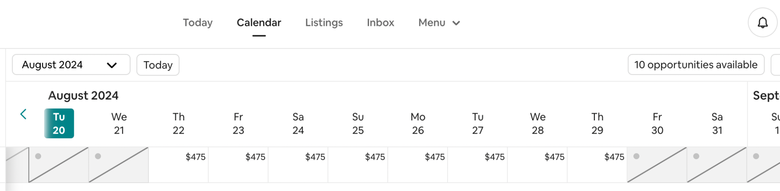
Objective
Build a regressor that will adequately provide airbnb hosts with reasonable prices to charge during any week of the year.

Slide 4
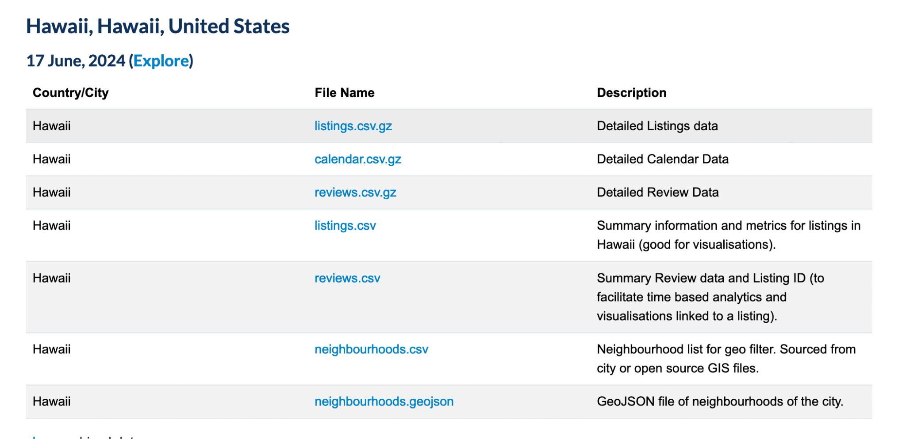
Dataset
Inside airbnb: https://insideairbnb.com/get-the-data/
Listings.csv.gz
-Contains detailed information about each listing (bedrooms, bathrooms, latitude, longitude, etc
Calendar.csv.gz
-Contains the price that was listed for each date in the time window.

Slide 5
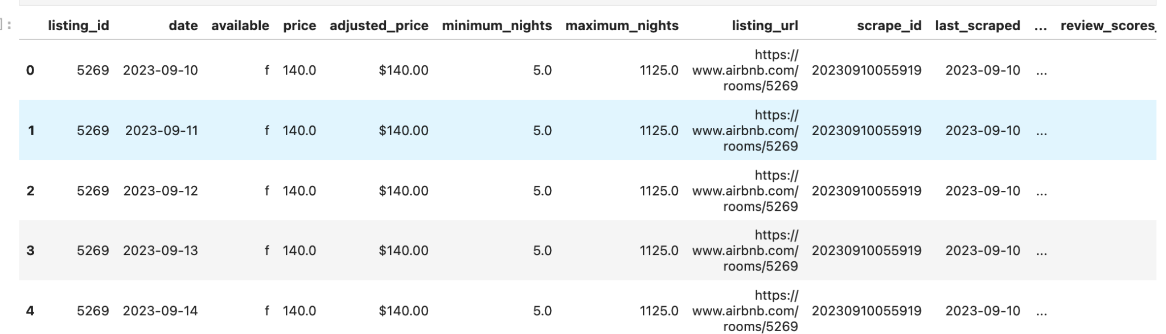
Merging Listings and Calendar
The listings and calendar data was combined to create a dataset with prices for each day along with other size and location features associated with the listing.
Rows: 2,181,240 Columns: 78

Slide 6
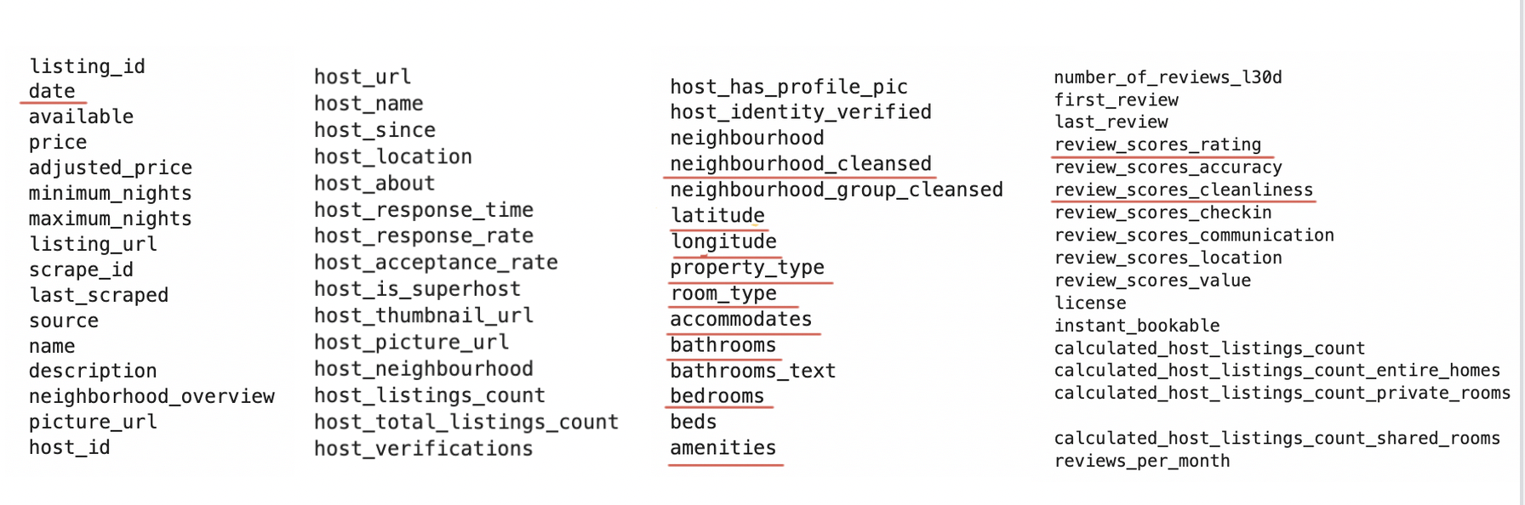
Potential Features
The data set came with 78 columns which are shown below. Underlined are the columns that were either used as features directly, or used for feature extraction.

Slide 7
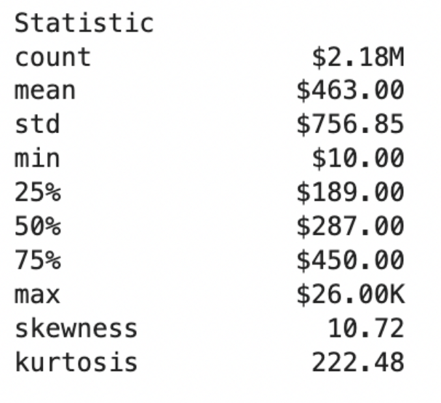
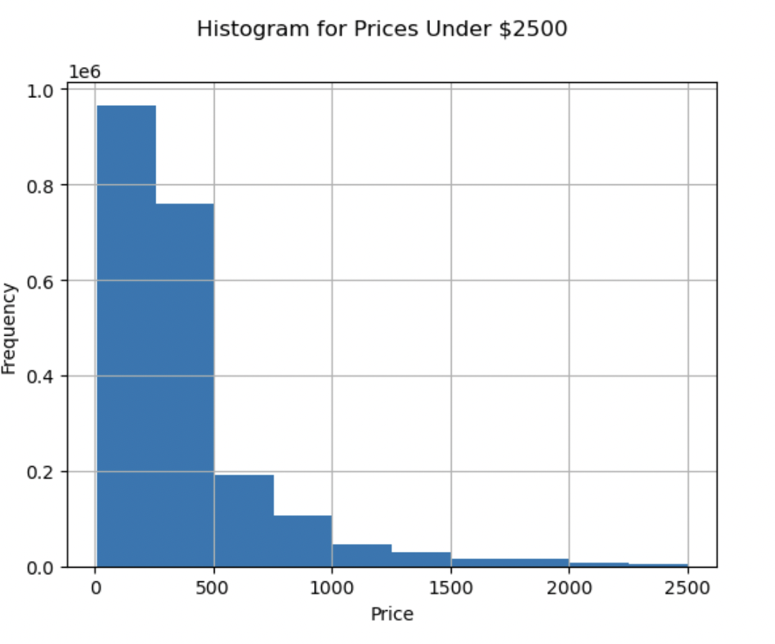
Target Variable Statistics
Range: $25.99 K
Summary: The average price is $463.00 (median: $287.00), ranging from $10.00 to $26.00k

Slide 8
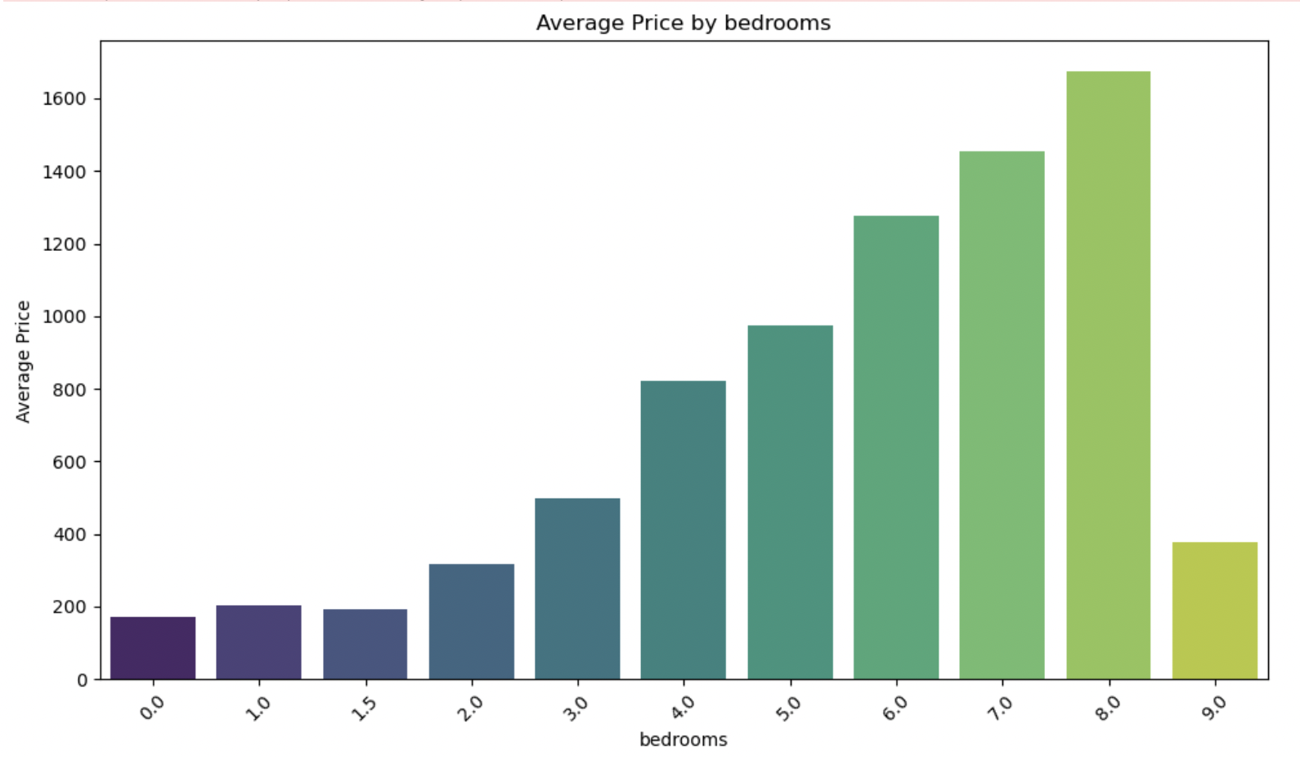
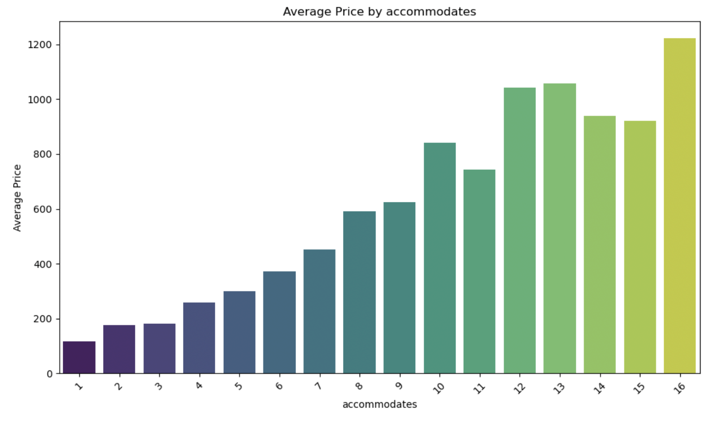
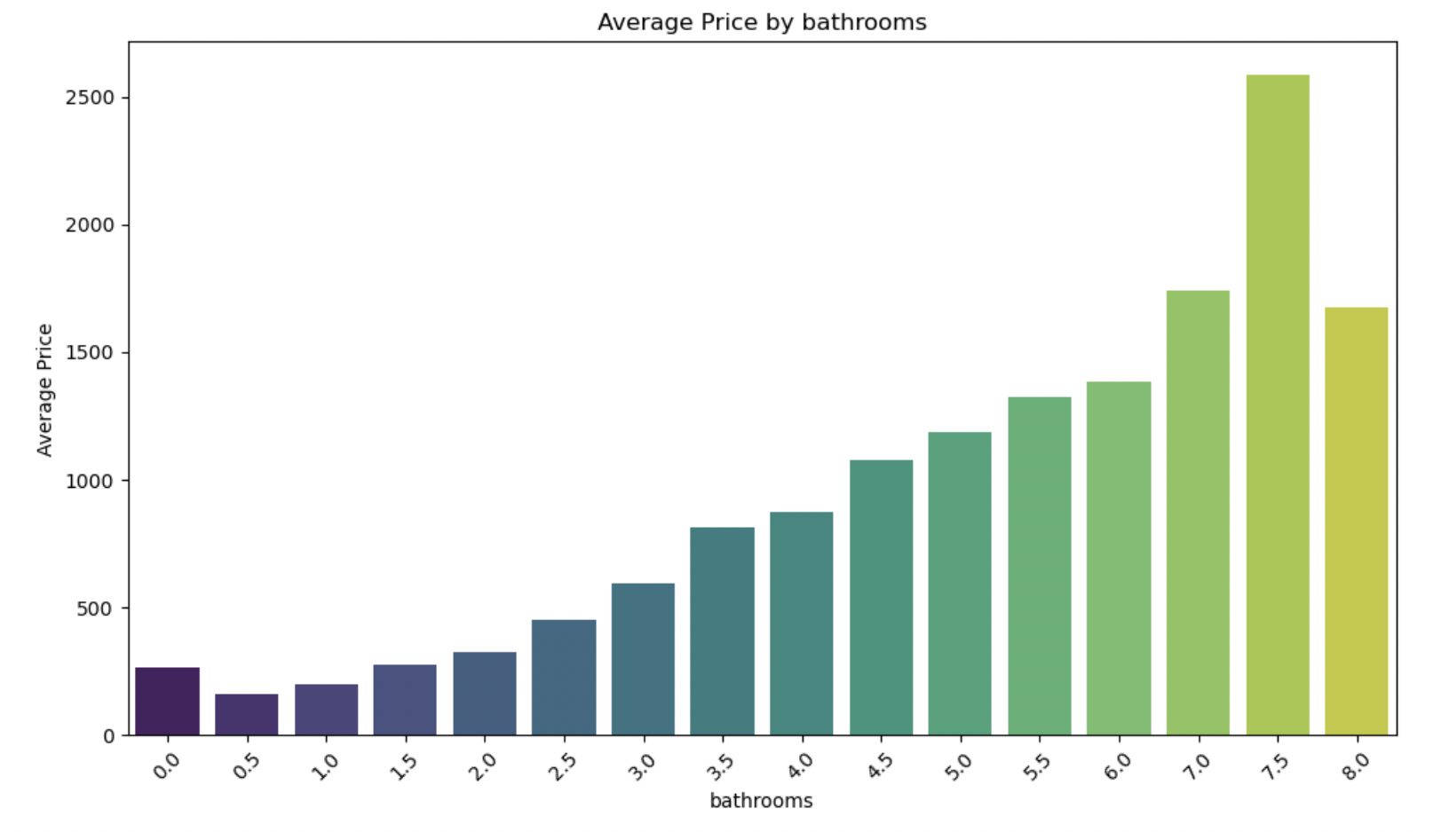
Size Related Features
Bedrooms
Bedrooms, bathrooms, and guests accommodated are some of the most important features that will be used for this model. They all show a strong monotonic relationship with the target variable. Notice that the number accommodated increases as the price increases in a somewhat linear fashion. however, at higher values this pattern begins to break.
Accommodates
Bathrooms

Slide 9
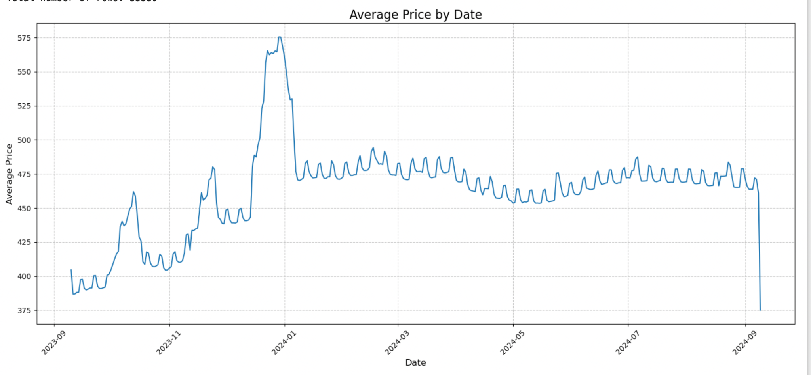
Price Over Time
In hawaii the high season for short term rentals is in the winter months. We see an overall increase in price from October to the middle of january, with major up swings during the Thanksgiving, Christmas and New Years holidays.

Slide 10
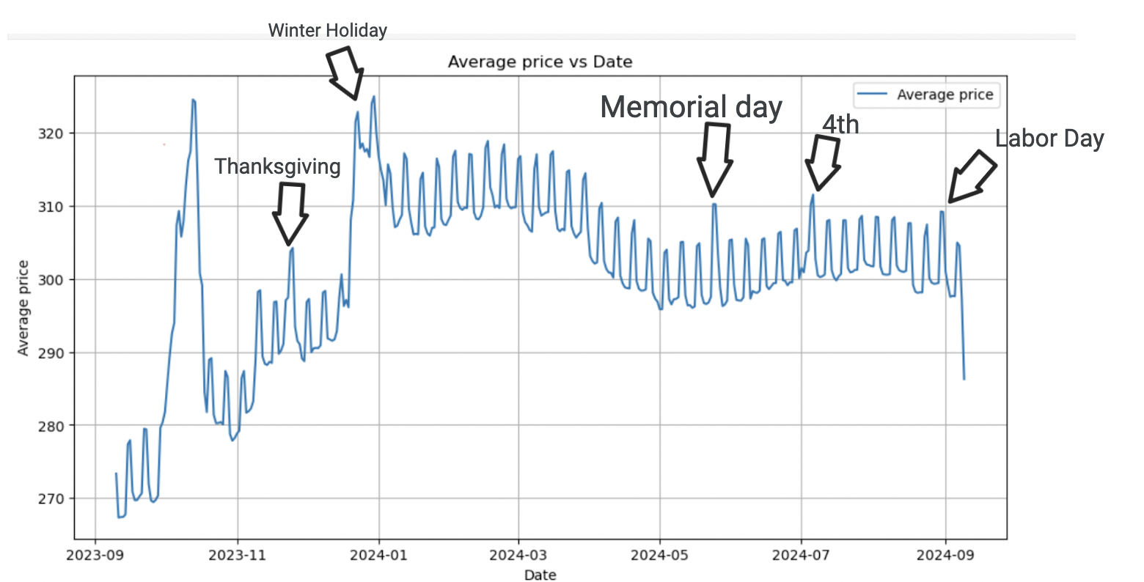
Feature Extraction: isHoliday
-The first feature that I built was the ‘isHoliday’ feature. I removed some outliers and investigated the price over time graph. It showed spikes during most major holidays.

Slide 11
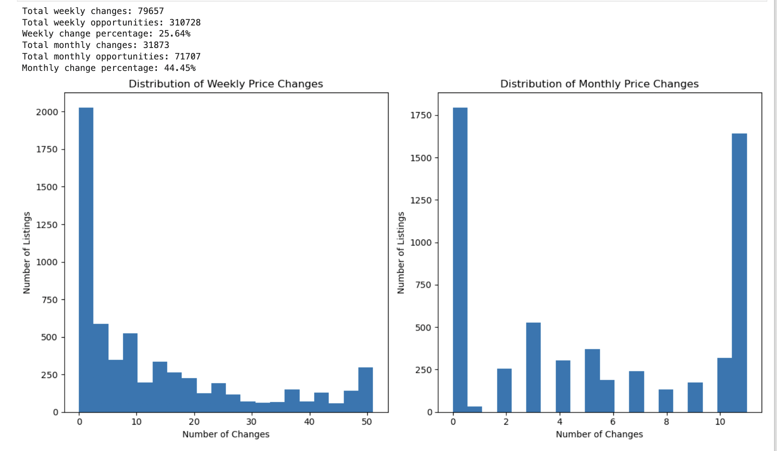
Feature Extraction: Time
Because the data contains many different days where listings have the same price, I decided to aggregate the data by week. I decided that enough people were changing their prices on a weekly basis to justify aggregating by week.
-Prices are changed on a weekly basis roughly 25% of the time.
-Prices are changed on a monthly basis 44.45%

Slide 12
Summary of Time Related Features
-Month was also kept as a feature that would serve as a flag in order to capture seasonal changes.
Summary of time/seasonal related features
-Time (integer 1-58)
-Month (integer 1-12)
-IsHoliday (boolean)

Slide 13
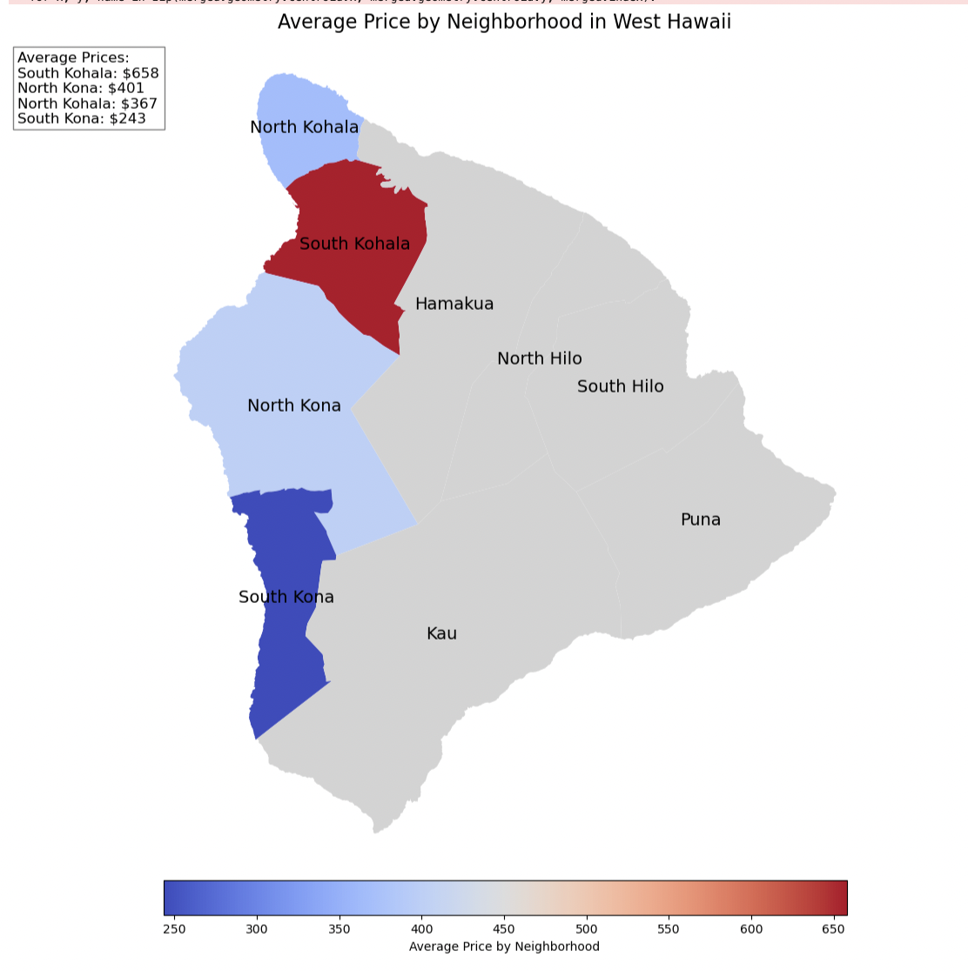

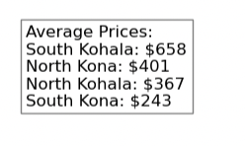
Feature Extraction: Location
The listings csv provided a column called ‘neighbourhoods’ which identified each listing by a general geographic location. Prices in the South Kohala area showed to be higher than in other areas. South Kona had the lowest average price. These locations were used as features.

Slide 14
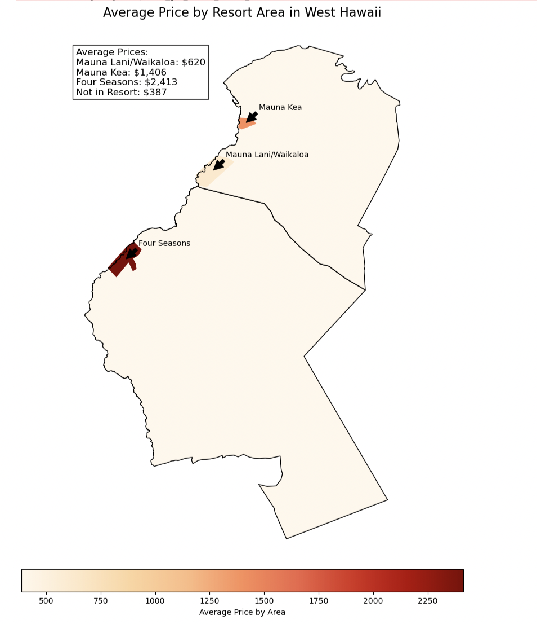
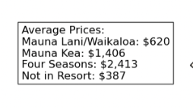
Feature Extraction:Resort Areas
I defined 3 major resort areas to serve as categorical features.

Slide 15
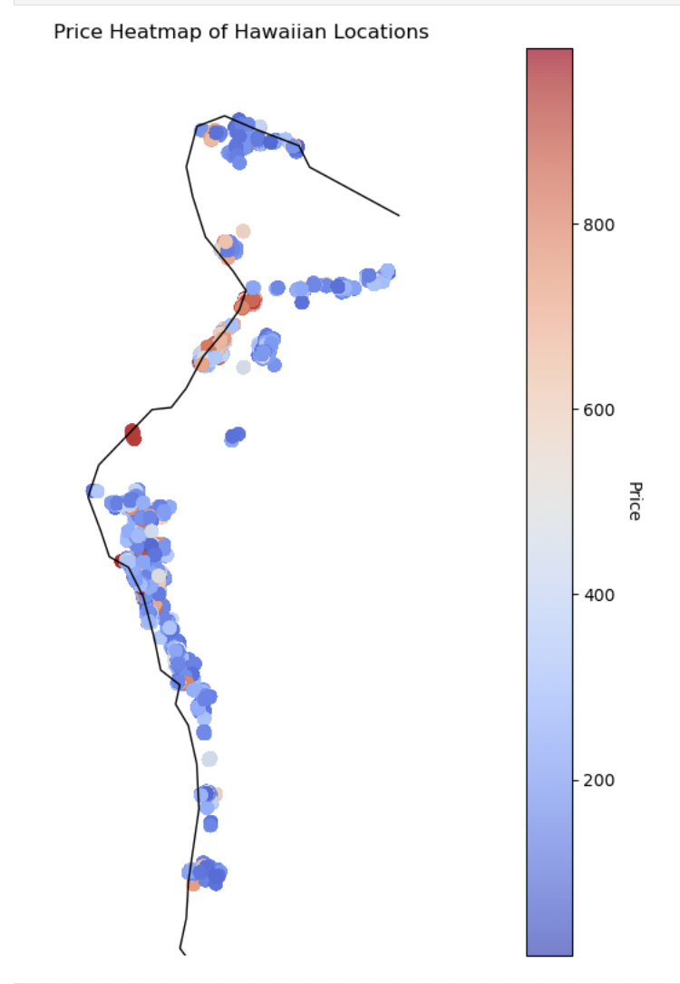
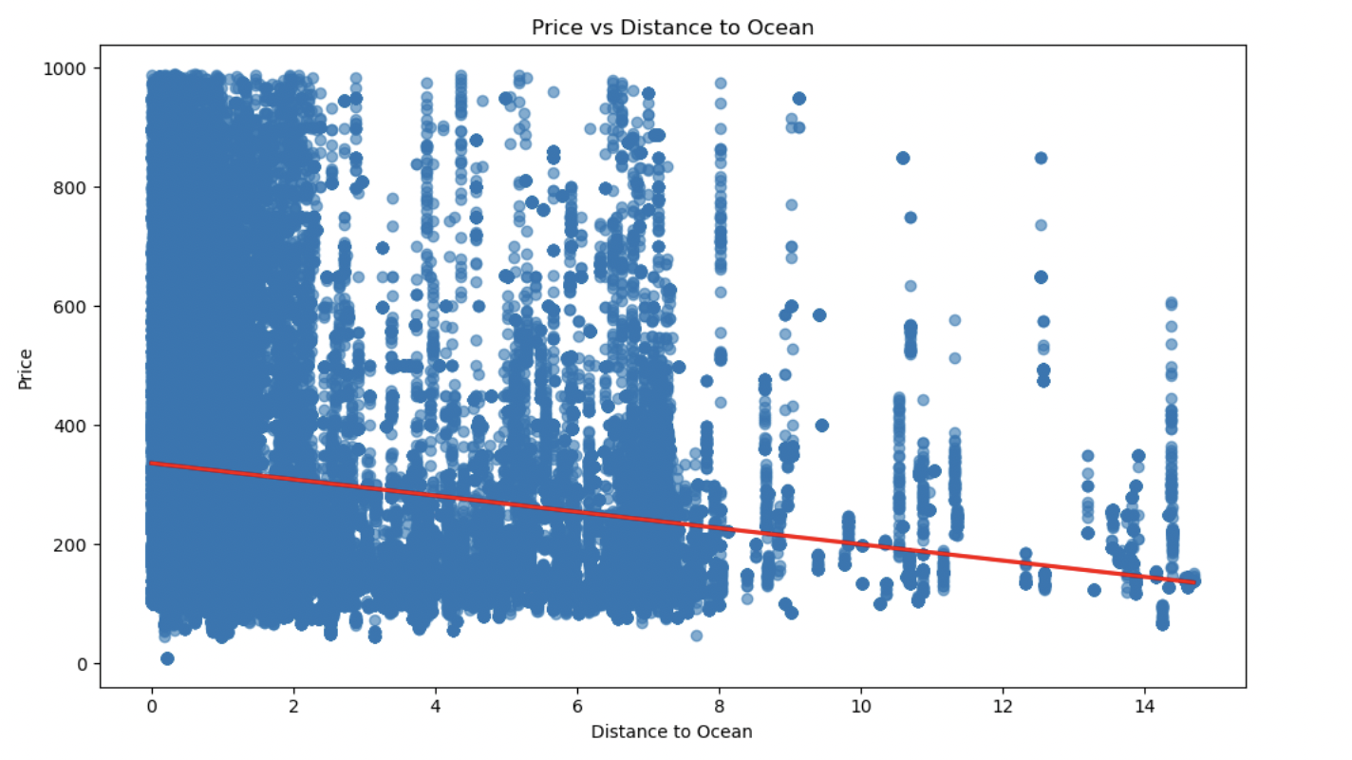
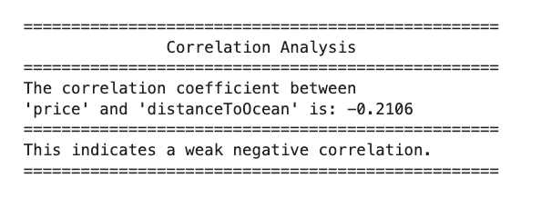
Feature Extraction:Ocean Proximity

Slide 16
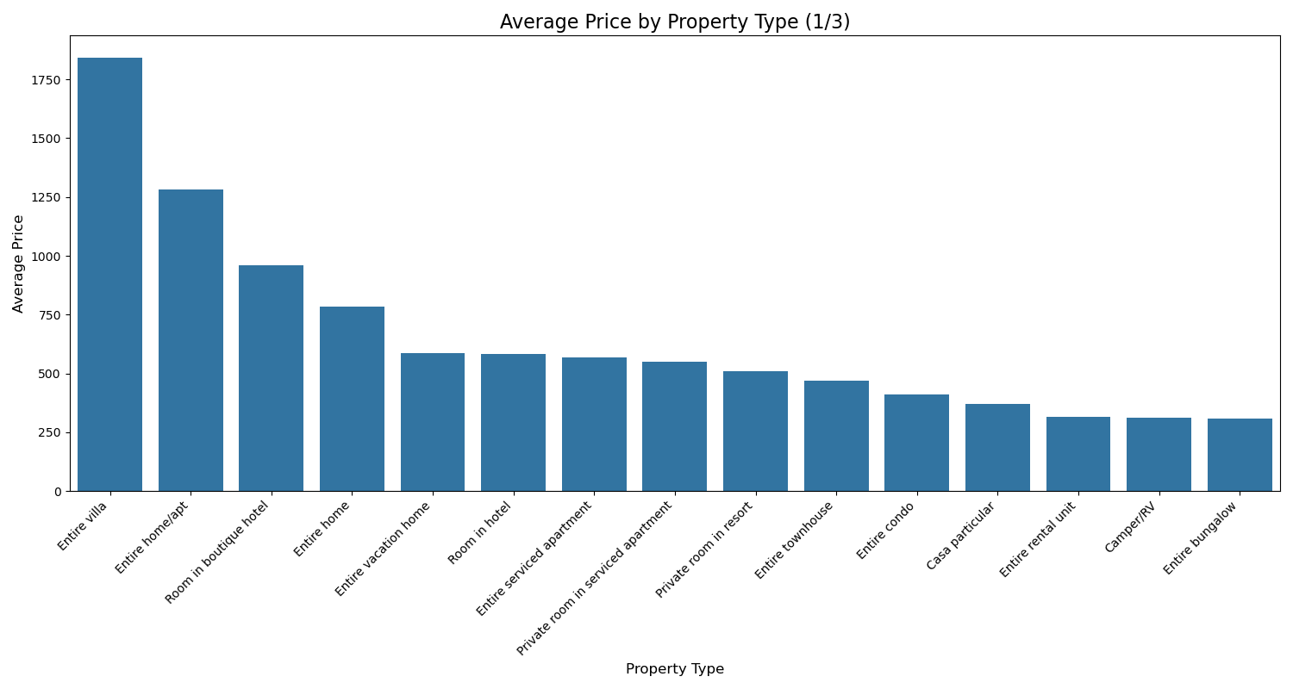
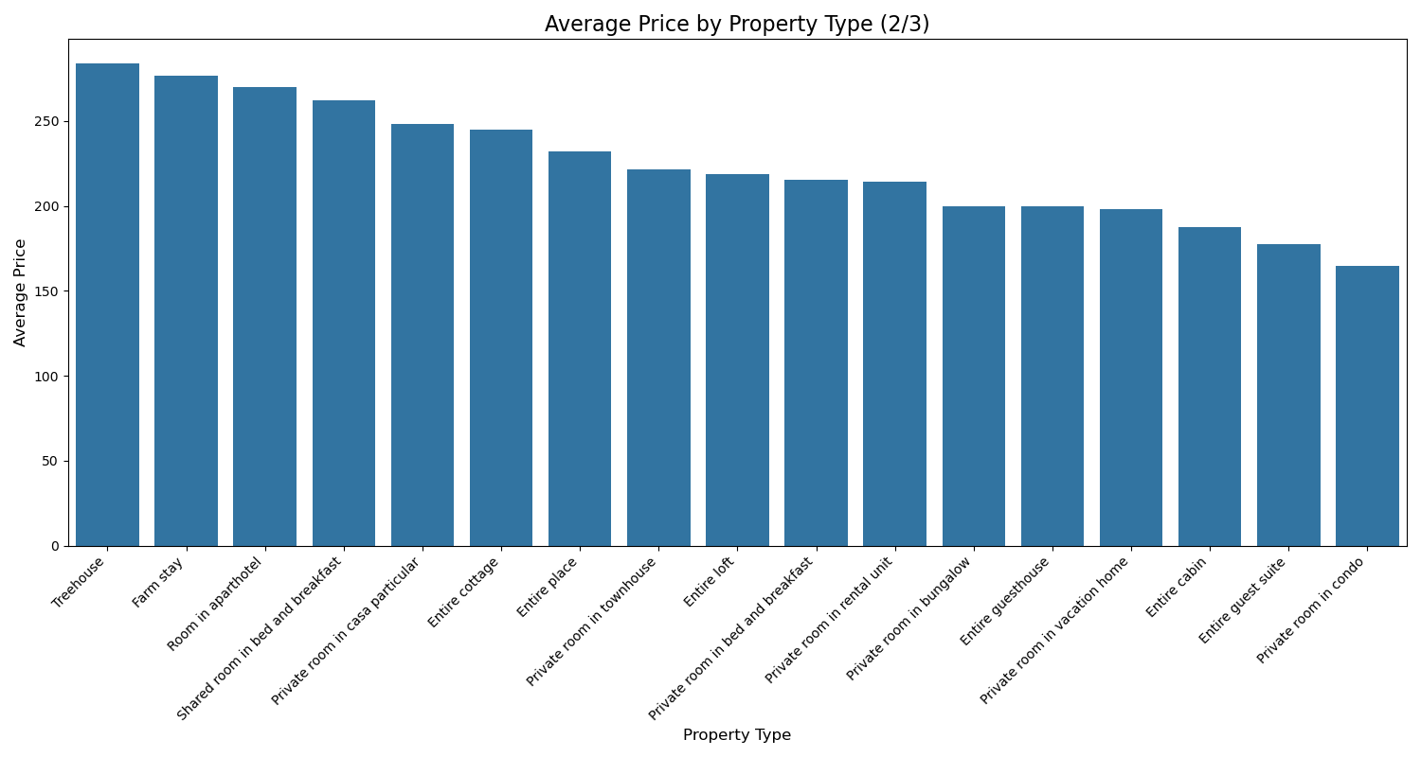
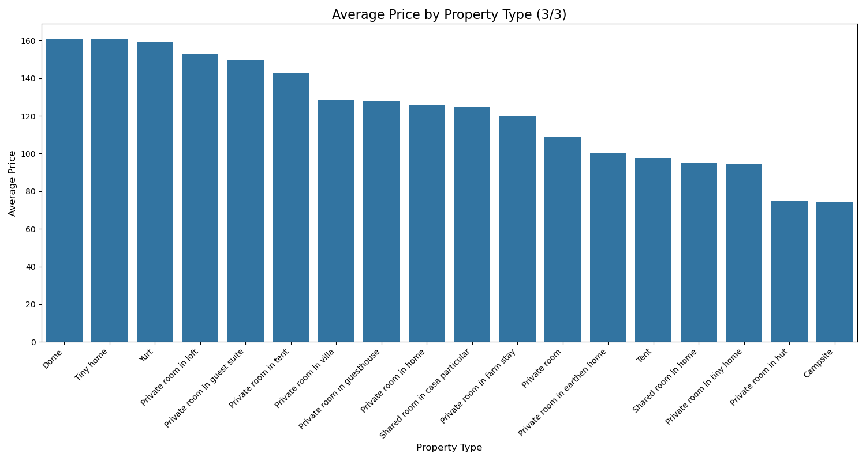
Feature Extraction: Property Group
There were many property types represented in the dataset. Many of them fell into the same price category so i decided to place property types into smaller groups that were then used as features.

Slide 17
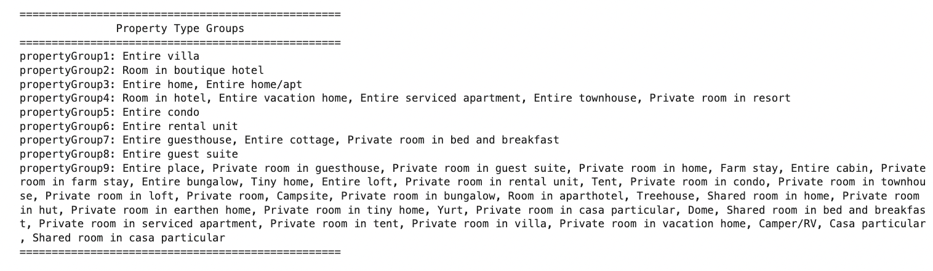
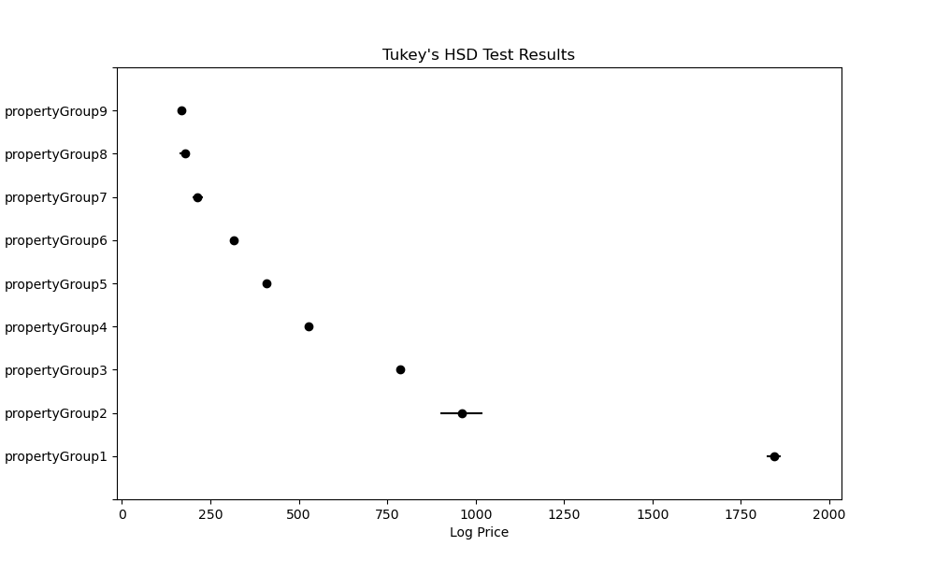
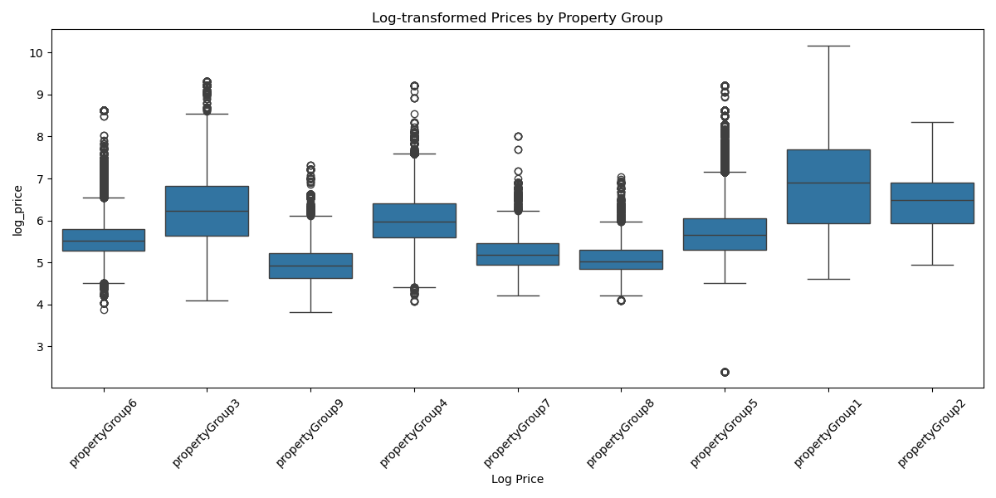
Categorizing property types into smaller groups
Property types were put into smaller groups based on there similarities in price. ANOVA and subsequent Tukey tests showed that each of the groups was significantly different from each other.

Slide 18
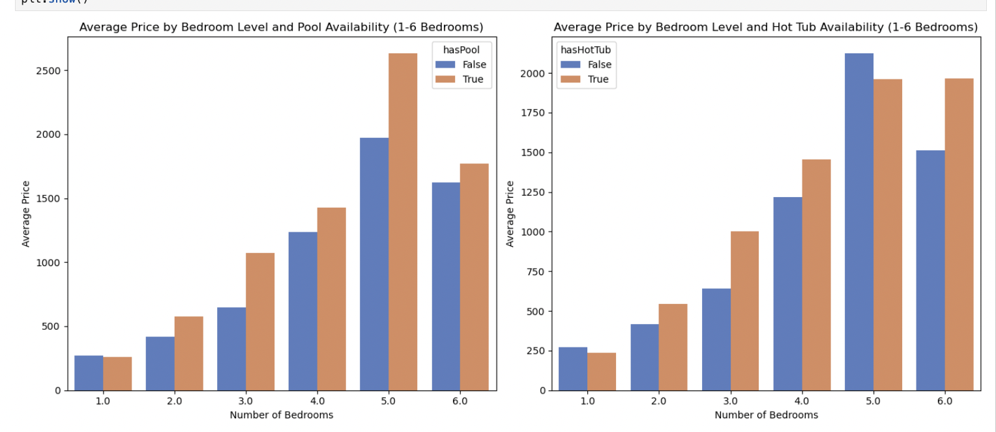
Feature Extraction: Amenity Related Features
The amenities column was used to determine if the listing had a private pool/hot tub. There were many listings that mentioned a pool/hot tub in their listing, however it was found that only the mention of a ‘private’ pool/hot tub provided meaningful variation in price. The ‘hasPool’ and ‘hasHotTub’ features were set to True only if the amenities column specifies a ‘private’ pool or hot tub.

Slide 19
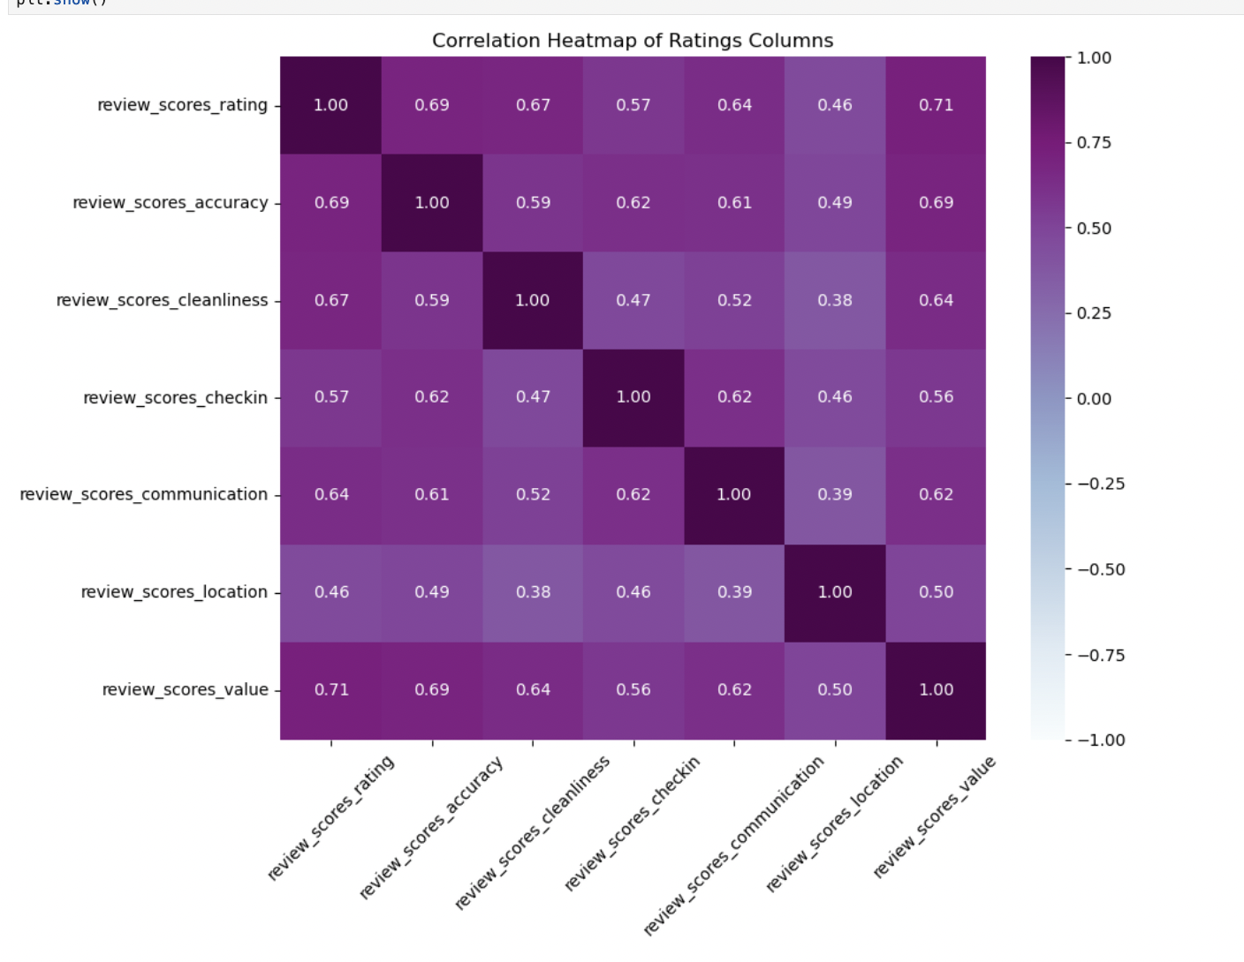
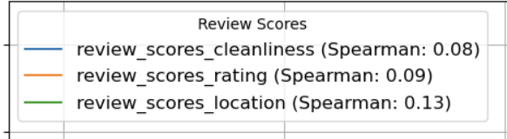
Feature Extraction: Ratings Features
I chose three ratings columns to use as features. I tried to choose ones that were not as correlated with each other. The following three columns were selected as features.
-Review_scores_cleanliness
-Review_scores_location
-Review_scores_rating (overall rating)
The features are not very highly correlated with price.
Correlation with Price

Slide 20
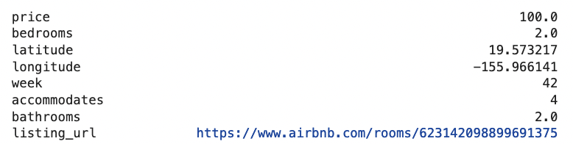
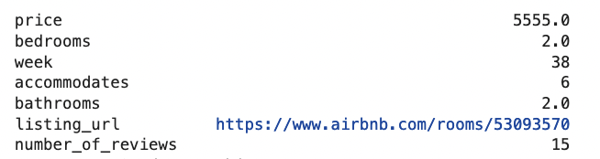
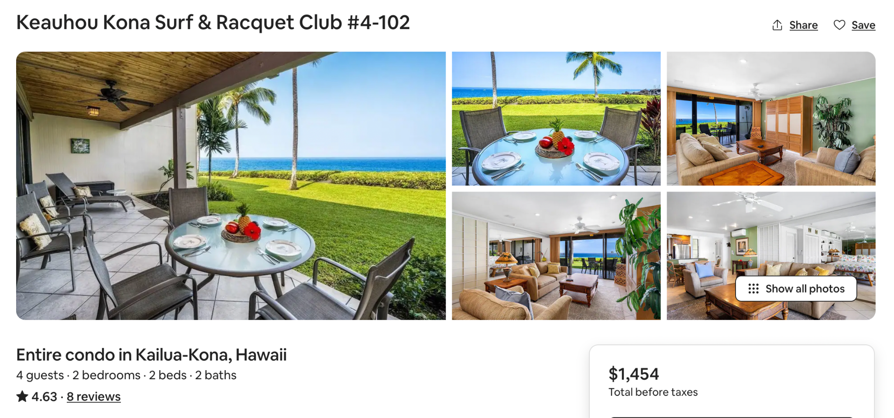
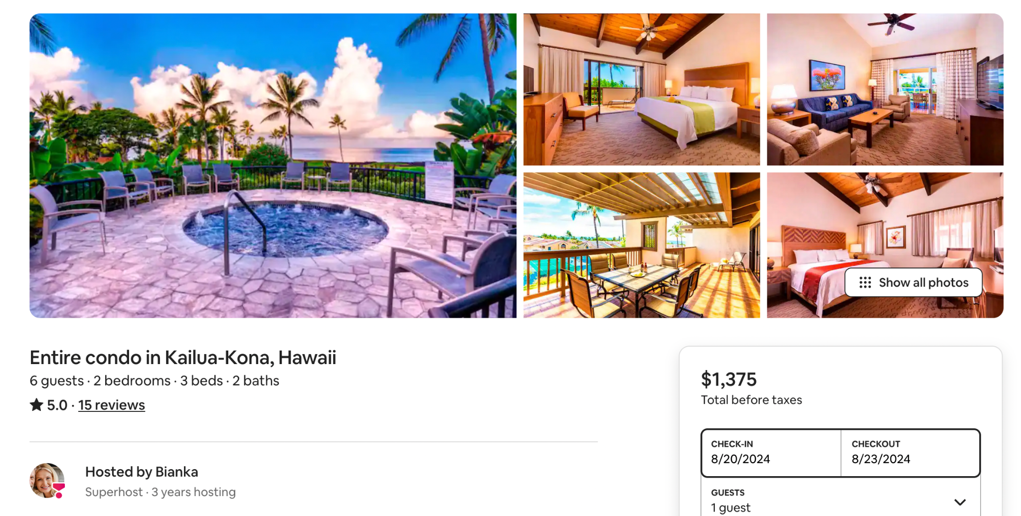
Data set Challenges:
Mislabeled Prices
Price in data set: $100
Price in data set: $5555 /night
Price on website: $484/night approx
Price on website: $458/nights approx

Slide 21
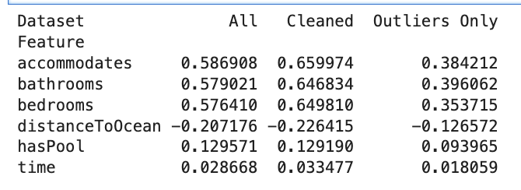
Removing Data points
-To prevent machine learning models from getting confused by data that is either incorrectly entered, or does not capture the underlying relationship between the features and the target, certain observations were removed.
What was Removed?
Correlation before and after cleaning
-Very High priced Units
- Units where the predicted log price from a linear regression was 50% higher than the actual price.
- Units that had very little reviews.
Number of Data Points Removed:
37,617 (10.85%)

Slide 22
Train-Test Split
-The data needed to be carefully split so that the test set would represent truly unseen data. Since there are multiple rows for each listing, the training and testing sets were split by listing. 80% of the listings were used for training, while 20% was used for testing.
Length of Training set: 247,239
Length of Testing set: 61,725

Slide 23
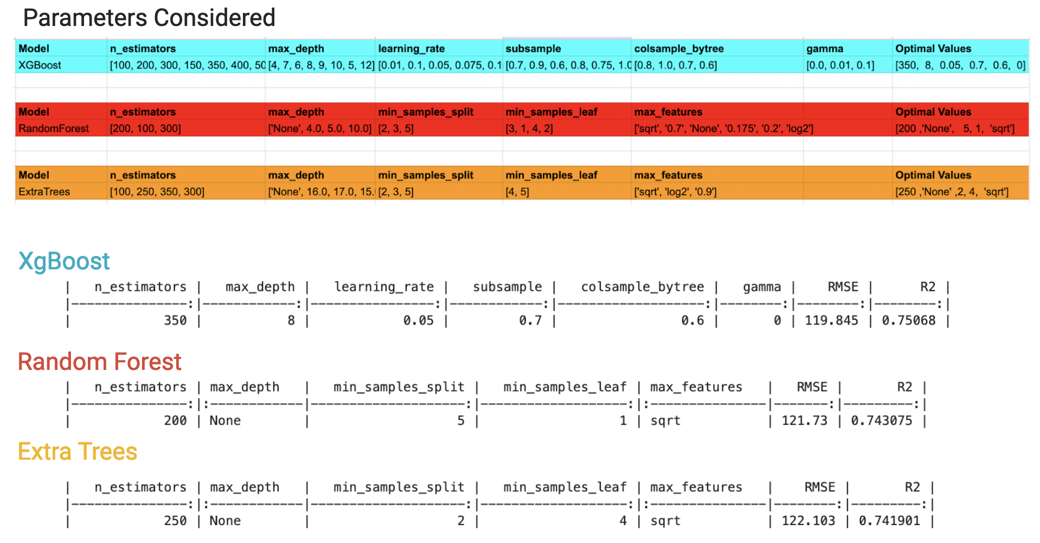
Model Fitting

Slide 24
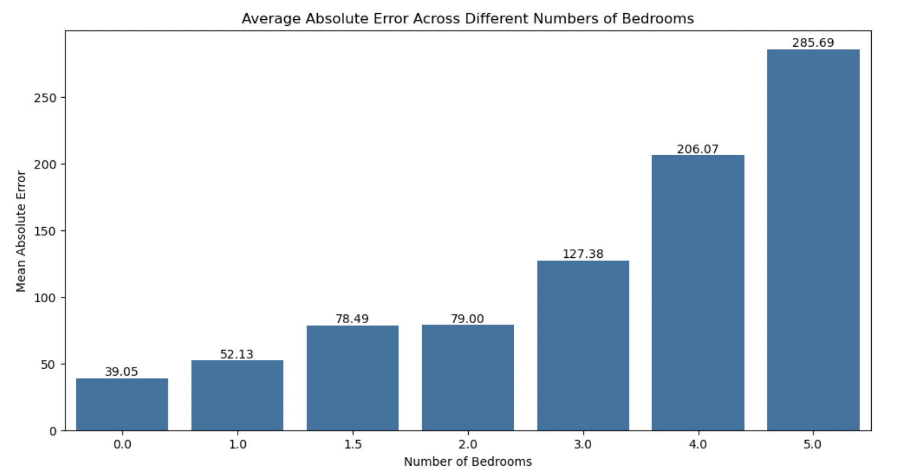
Distribution of Residuals
The residuals are monotonically related to the number of bedrooms. Listings with higher bedrooms tend to have more error. Predictions for studios and 1 bedroom units are off by roughly $40 on average, predictions for 1.5 and 2 bedrooms are off by about $79 on average. 3 bedroom units have an average absolute error of $127.38.

Slide 25
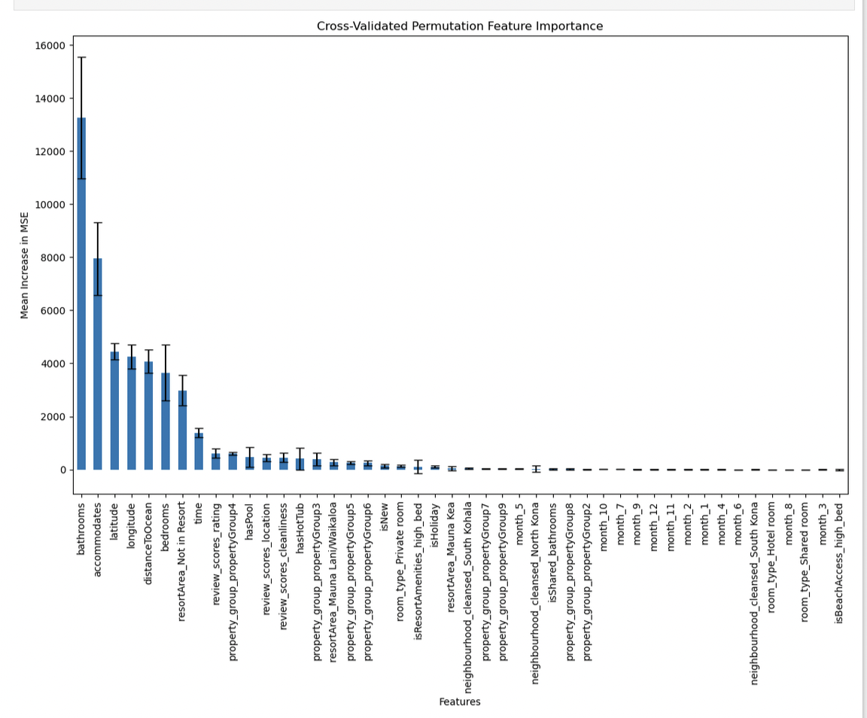
Feature Importance
The importance of each feature was tested by taking the best model and making predictions with a randomly shuffled version of each feature. This was done 12 times and the decrease in MSE was recorded. This was cross validated over 5 folds. The y-axis represents the average decrease in MSE caused by shuffling the feature, over the 12 permutations and 5 folds.
Features that did not change the MSE or caused the model to perform worse were removed before the final model was fit.

Slide 26
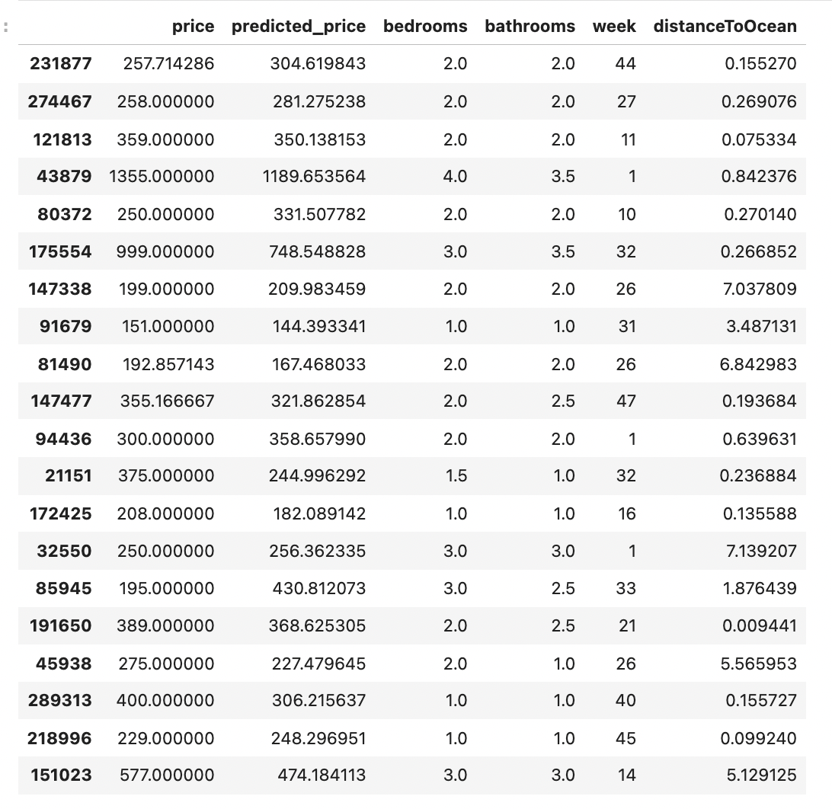
A Look at Predictions

Slide 27
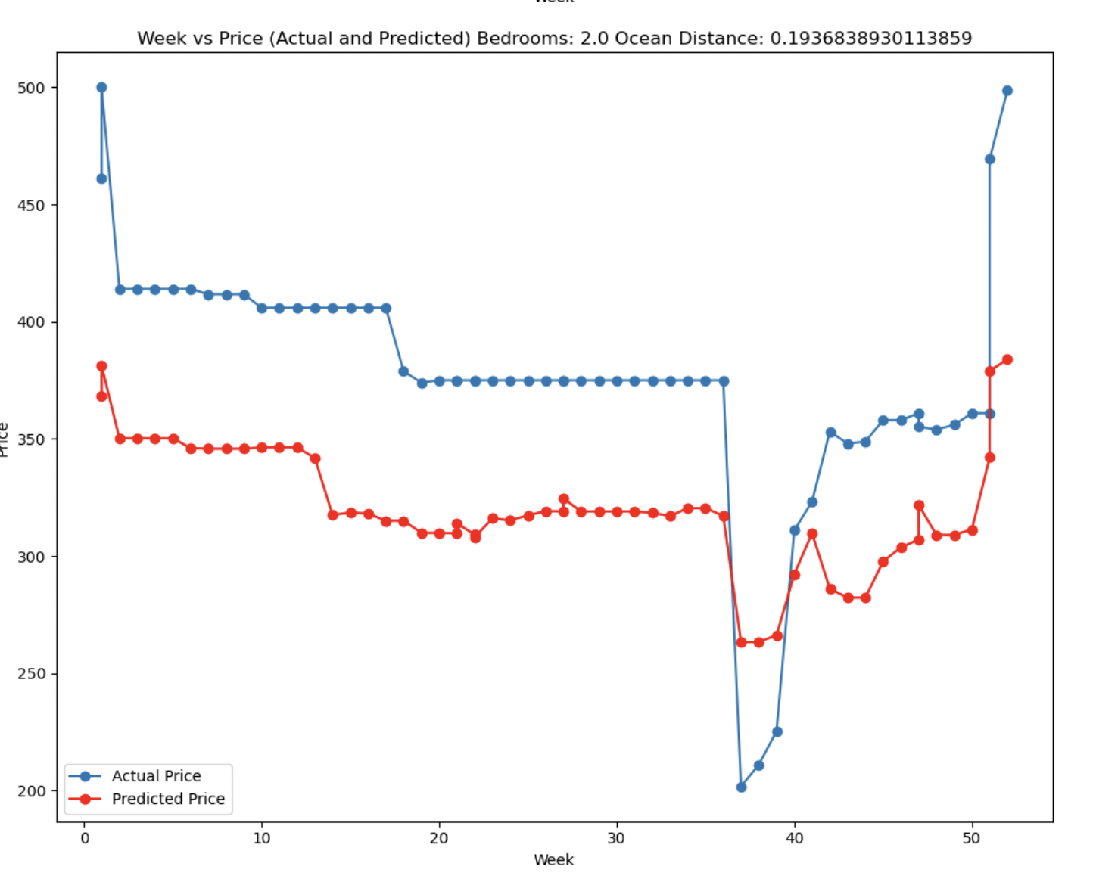
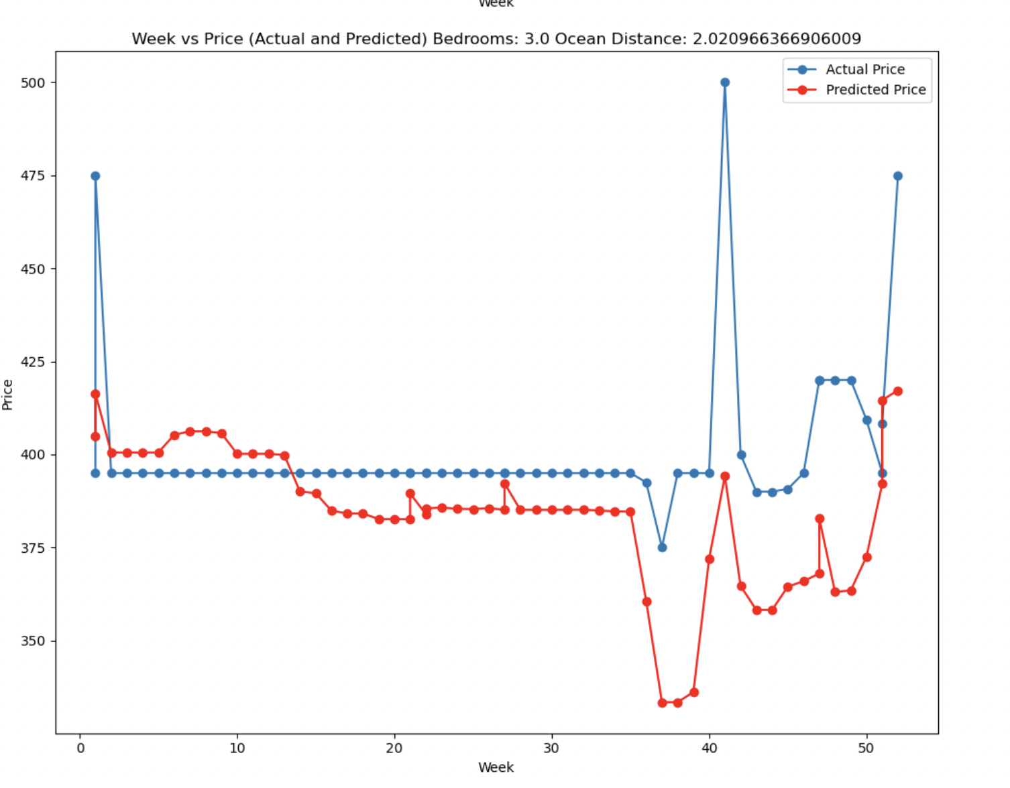
Comparing the predicted price over time to the actual price over time.
The graphs below show two listings predicted price and actual price as it changes over time. We can see that the models predictions mimic the actual behavior of the hosts price choices as time goes by. Frequently a change in the actual price will correspond with a similar change in predicted price. The correspondence does not necessarily happen on the same date, but it is frequently close.
2 bedroom
3 bedroom

Slide 28
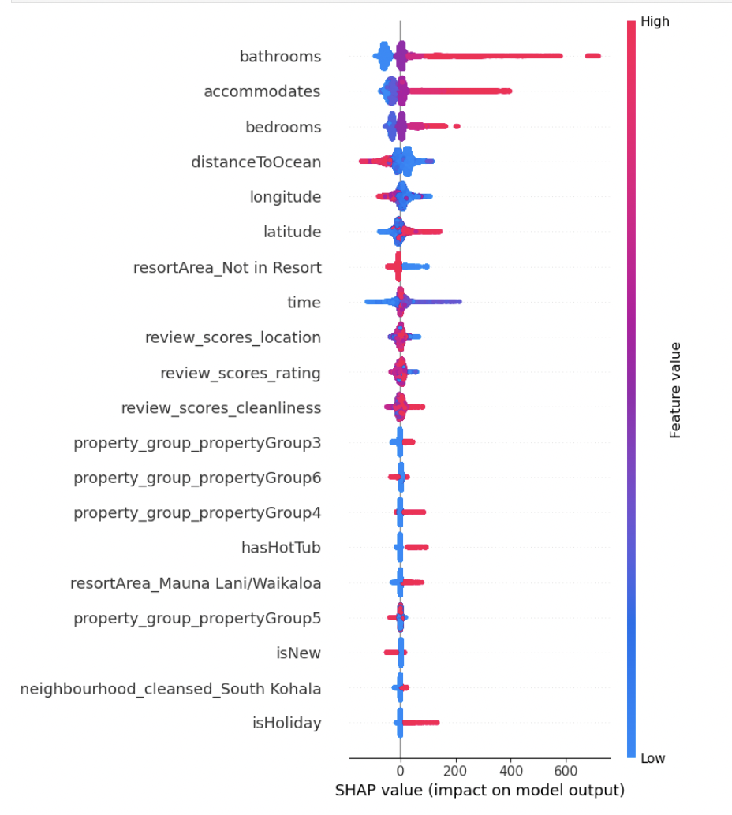
Conclusion and SHAP Analysis
Possible Ways to Improve The Model
The model is able to provide reasonable predictions and is making logical decisions based on the specific feature values for each listing. The graph at right shows how the model is adjusting its predictions based on the specific feature value. Points on the right side mean that the prediction increased as a result of the feature value. The feature value is indicated by the color bar.
Data Augmentation- Add more examples of larger sized listings.
Extract other features-Find new features that can help explain differences at specific size levels.
Find cleaner data-The data set used is scraped data. Some of the data may not be 100% reliable. For example, sometimes listings may be posting there weekly price instead of nightly.

